Slide 1

Boat in river with mountain background
Computer Graphics(Lab) CSE-422
Submitted to
Maria Afnan Pushpo
Lecturer
Primeasia University

Slide 2
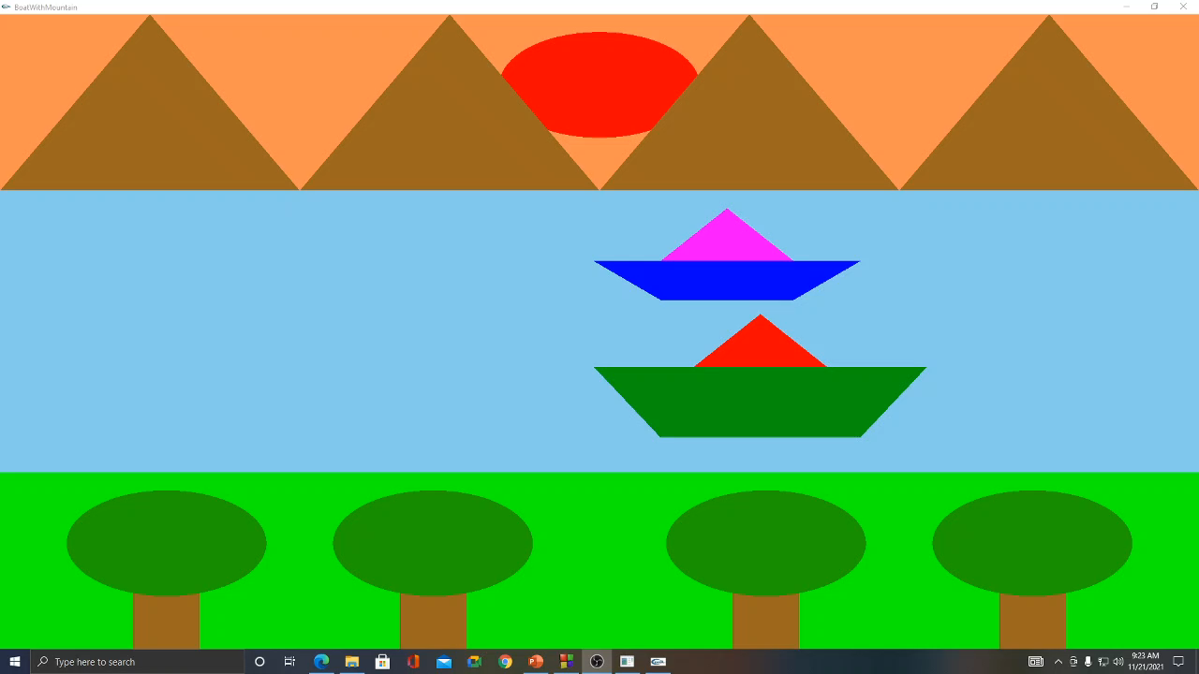
Project Output

Slide 3
Layers
In this project there are three layers used as background. First layer of background is represented as sky full of light of the sun. where we can see the mountains and the sun. In second layer we can see the river the boat are moving. And In the bottom layer we can see some grounds of grass and some trees over there. Here I used Opengl Quads for creating the backgrounds.
Here is a sample code for the background to show.
glPushMatrix();
glBegin(GL_QUADS);
glColor3f(0.99,0.56,0.31);
//Define verticess of quad
glVertex3f(-9.0, 4.0, 1.0);
glVertex3f(9.0, 4.0, 1.0);
glVertex3f(9.0, 9.0, 1.0);
glVertex3f(-9.0, 9.0, 1.0);
glEnd();
glPopMatrix();

Slide 4
First Layer(Mountain)
In this project mountains are created with triangles with x,y positioned. In the Output you can see four triangles in the top layer representing mountains of the picture.
Here is a sample code for the mountain to show.
glPushMatrix();
glBegin(GL_TRIANGLES);
glColor3f(0.60,0.40,0.12);
glVertex3f(-9.0, 4.0, 0.0);
glVertex3f(-4.5, 4.0, 0.0);
glVertex3f(-6.75, 9.0, 0.0);
glEnd();
glPopMatrix();

Slide 5
First Layer(Sun)
In this project Sun is created with Opengl Polygons iterating 360 times with x,y positioned. In the Output you can see the red Circle in the top layer representing the sun of the picture.
Here is a sample code for the circle to show.
float theta;
glPushMatrix();
glColor3f(1.0,0.0,0.0);
glBegin(GL_POLYGON);
for(int i=0;i<360;i++)
{
theta = i*3.142/180;
glVertex2f(1.5*cos(theta),7+1.5*sin(theta));
}
glEnd();
glPopMatrix();

Slide 6
Second Layer(River)
In the second layer you can see a skyblue background which represents a river mountain side. It was also created with openGL QUADS.
Here is a sample code for the river to show.
glPushMatrix();
glBegin(GL_QUADS);
glColor3f (0.52, 0.80, 0.92);
glVertex3f(-9.0, -4.0, 1.0);
glVertex3f(9.0, -4.0, 1.0);
glVertex3f(9.0, 4.0, 1.0);
glVertex3f(-9.0, 4.0, 1.0);
glEnd();
glPopMatrix();

Slide 7
Second Layer(Boat)
In this section of project we created boats in the river. I used OpenGL quads for the boat bottom option and I used Triangle for top portion of the boat. You can see two types of boats here one is small, one is large.
Here is a sample code for the large boat Top portion…
glPushMatrix();
glBegin(GL_TRIANGLES);
glColor3f(1.0,0.0,0.0);
glVertex3f(-7.5+n, -1.0, 0.0);
glVertex3f(-5.5+n, -1.0, 0.0);
glVertex3f(-6.5+n, 0.5, 0.0);
glEnd();
glPopMatrix();
Here is a sample code for the large boat Bottom portion…
glPushMatrix();
glBegin(GL_QUADS);
glColor3f(0.0, 0.6, 0.05);
glVertex3f(-8.0+n, -3.0, 0.0);
glVertex3f(-5.0+n, -3.0, 0.0);
glVertex3f(-4.0+n,-1.0, 0.0);
glVertex3f(-9.0+n, -1.0, 0.0);
glEnd();
glPopMatrix();

Slide 8
Second Layer(Boat Animation)
We can also see the boat animation in the picture. I changed the x position overtime and redisplayed the boat with glutPostRedisplay() function.
Here is a sample code for the animation to show.
if(boat==0)
{
if(n<9){
n+=0.003;
glutPostRedisplay();
}
else{
n=n-9;
glutPostRedisplay();
}
}

Slide 9
Third Layer(Trees)
In this layer you can see green background made with OpenGL QUADS representing grass. And you can see some trees over there also. Trees are made with quads and circle made with polygon iteration.
Here is a sample code for the trees.
glPushMatrix();
glBegin(GL_QUADS);
glColor3f(0.60,0.40,0.12);
glVertex3f(-7.0, -9.0, 0.0);
glVertex3f(-6.0, -9.0, 0.0);
glVertex3f(-6.0, -6.0, 0.0);
glVertex3f(-7.0, -6.0, 0.0);
glEnd();
glPopMatrix();
treeHead(-6.5,-6);
void treeHead(float x, float y){
float theta;
glPushMatrix();
glColor3f(0.123,0.63,0.0);
glBegin(GL_POLYGON);
for(int i=0;i<360;i++){
theta = i*3.142/180; glVertex2f(x+1.5*cos(theta),y+1.5*sin(theta));
}
glEnd();
glPopMatrix();
}

Slide 10
Thank you created by Tanvir Anjum labir 191039042 department of cse

